Slide 1
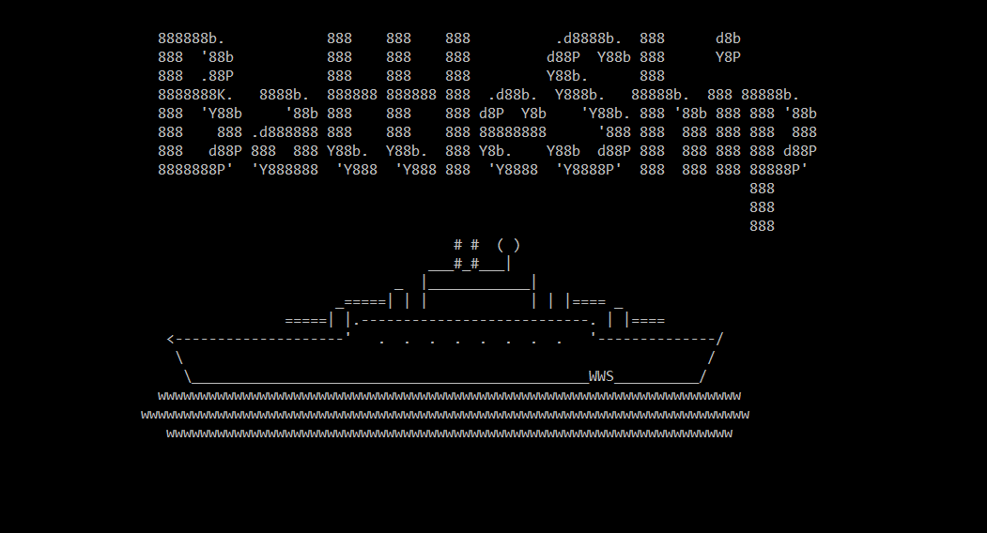
Week 2: Battleship

Slide 2
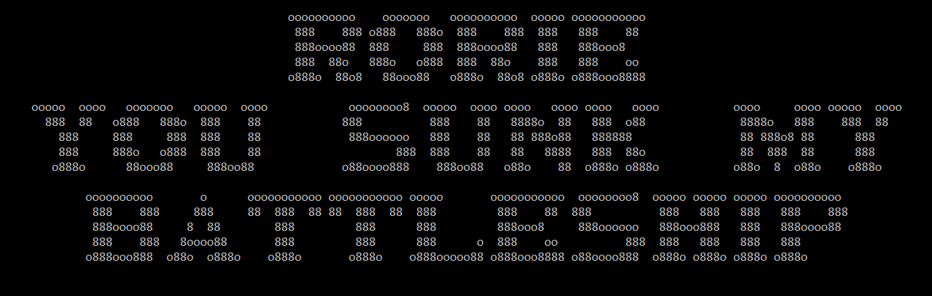
Strengths
Validation is strong
Meets all constraints
Player class constructor instantiates a 2d array for each player that hold ship location and ShotStatus in one place.
Players see both their board with ships and the shots they have fired on their opponent.
Sweet victory screen.
Needs Improvement
More uniformity with error messages
GameFlow still contains too much probably.
PlaceShip logic (BLL) somewhat duplicated
ShotHistory not used. Instead used outgoing data to FireShot and incoming ShotResponse enum.

